Slide 1



Fixed transaction ordering and admission in blockchains
PhD advisors:
João Barreto
Miguel Matos
PhD stage:
Early stage. Started March 2017.
Research area:
Distributed systems, blockchains, Ethereum, total order, dissemination.
Paulo Mendes da Silva
psilva@gsd.inesc-id.pt
INESC-ID / IST
Universidade de Lisboa

Slide 2
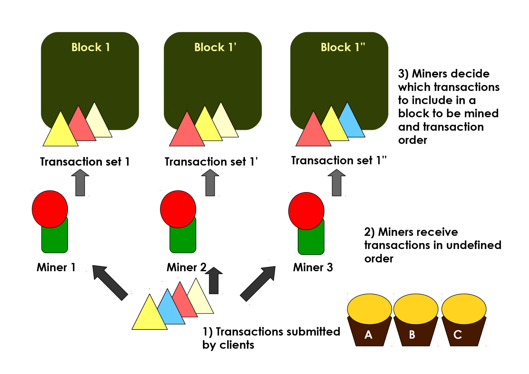
Work motivation and overview
Ethereum transaction execution order and admittance are unreliable.
Insufficient funds, double spending attacks and long transaction commit times.
Fixed transaction ordering and admission to blockchains
Reduced transaction commit time and no transaction censorship.

Slide 3
Approach
Develop a Fixed Transaction Ordering and Admission (FTOA) algorithm for Ethereum.
Prevent miners from deciding how to order transactions and which transactions to include, using:
  Epidemic total order algorithm
  Logical timestamps
  Byzantine setting

Slide 4
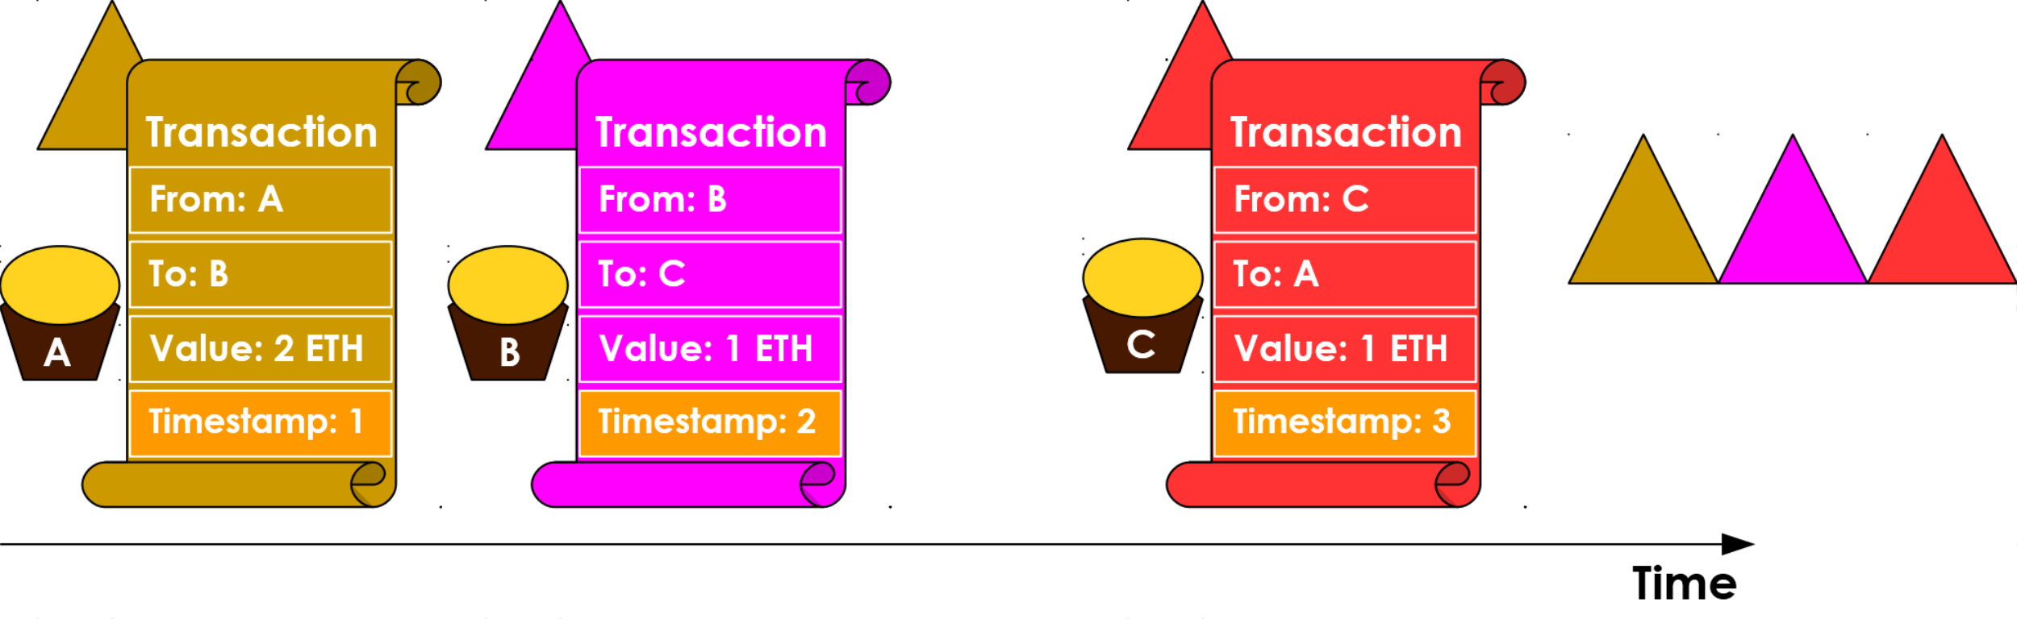

FTOA algorithm overview

Slide 5
Thank you.
Questions?
Recap: Prevent miners from deciding how to order transactions and which transactions to include, using an epidemic total order algorithm and logical timestamps in a Byzantine setting.
Blockchains. Ethereum. Transaction ordering. Epidemic total order with logical timestamps in Byzantine setting. Fixed transaction ordering and admission.
Acknowledgements: This work is supported by the Portuguese National Science Foundation under Grants with references SFRH/BD/130017/2017 and UID/CEC/50021/2013.

