Slide 1
Memory-centric System Interconnect Design with Hybrid Memory Cubes
Gwangsun Kim, John Kim
Korea Advanced Institute of Science and Technology
Jung Ho Ahn, Jaeha Kim
Seoul National University

Slide 2
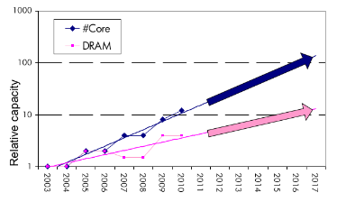
Memory Wall
Core count – Moore’s law : 2x in 18 months.
Pin count – ITRS Roadmap : 10% per year.
➔ core growth >> Memory bandwidth growth
Memory bandwidth can continue to become bottleneck
Capacity, energy issues and so on..
[Lim et al., ISCA’09]

Slide 3
Hybrid Memory Cubes (HMCs)
Solution for memory bandwidth & energy challenges.
HMC provides routing capability → HMC is a router
High-speed signaling
(Packetized high-level messages)
DRAM layers
TSV
Processor
Logic layer
MC
MC
…
MC
How to interconnect multiple CPUs and HMCs?
Interconnect
I/O
I/O
…
I/O
Ref.: “Hybrid Memory Cube Specification 1.0,” [Online]. Available: http://www.hybridmemorycube.org/,
Hybrid Memory Cube Consortium, 2013.
Packet

Slide 4
Memory Network
HMC
HMC
CPU
CPU
Memory
Network
HMC
HMC
HMC
…
…
HMC
HMC

Slide 5
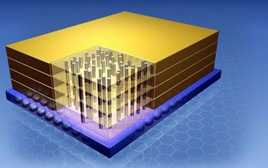
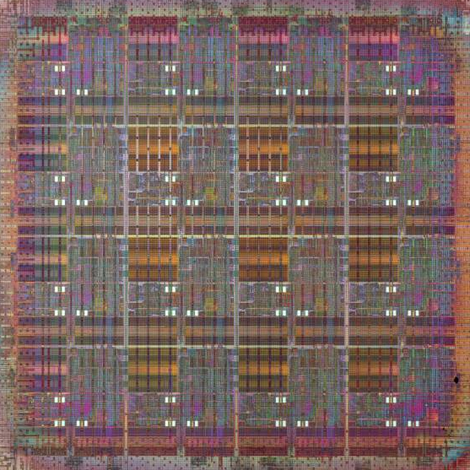
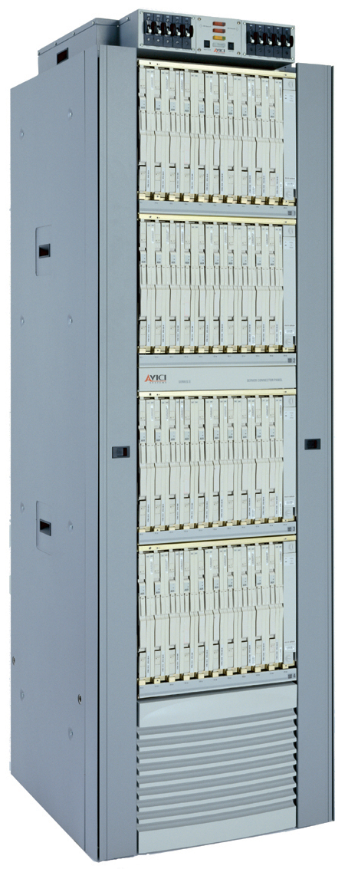
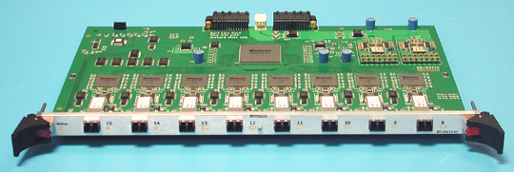
Interconnection Networks
Supercomputers
Memory
On-chip
Cray X1
MIT RAW
I/O
systems
Router
fabrics
Interconnection networks
Myrinet/Infiniband
Avici TSR

Slide 6
How Is It Different?
 | Interconnection Networks (large-scale networks) | Memory Network
Nodes vs. Routers
# Nodes ≥ # Routers
# Nodes < # Routers (or HMCs)
Network
Organization
Concentration
Distribution
Important Bandwidth
Bisection Bandwidth
CPU Bandwidth
Cost
Channel
Channel
Intra-HMC network
“Routers” generate traffic
Others

Slide 7
Conventional System Interconnect
Intel QuickPath Interconnect / AMD HyperTransport
Different interface to memory and other processors.
Shared parallel bus
CPU0
CPU1
High-speed P2P links
CPU2
CPU3

Slide 8
Adopting Conventional Design Approach
CPU can use the same interface for both memory/other CPUs.
CPU bandwidth is statically partitioned.
CPU0
CPU1
HMC
HMC
HMC
HMC
HMC
HMC
HMC
HMC
Same links
CPU2
CPU3
HMC
HMC
HMC
HMC
HMC
HMC
HMC
HMC

Slide 9
Bandwidth Usage Ratio Can Vary
Ratio of QPI and Local DRAM traffic for SPLASH-2.
Real quad-socket Intel Xeon system measurement.
We propose Memory-centric Network to achieve flexible CPU bandwidth utilization.
~2x difference in coherence/memory traffic ratio

Slide 10
Contents
Background/Motivation
Design space exploration
Challenges and solutions
Evaluation
Conclusions

Slide 11
Leveraging Routing Capability of the HMC
Conventional Design
Memory-centric Design
Local HMC traffic BW
CPU-to-CPU traffic BW
HMC
HMC
HMC
HMC
CPU
Coherence
Packet
CPU bandwidth can be flexibly utilized for different traffic patterns.
CPU
HMC
HMC
HMC
HMC
Bandwidth Comparison
Other CPUs
Other HMCs
50%
100%
50%
100%

Slide 12
System Interconnect Design Space
Network
…
…
HMC
HMC
HMC
HMC
CPU
…
CPU
…
…
HMC
HMC
HMC
HMC
CPU
…
CPU
…
…
CPU
CPU
HMC
HMC
HMC
HMC
…
Network
Network
Network
Processor-centric
Network (PCN)
Memory-centric
Network (MCN)
Hybrid Network

Slide 13
Interconnection Networks 101
Latency
Distributor-based Network
Pass-thru Microarchitecture
Throughput
Distributor-based Network
Adaptive (and non-minimal routing)
Average packet latency
Zero-load latency
Saturation throughput
Offered load

Slide 14
Memory-centric Network Design Issues
Key observation:
# Routers ≥ # CPUs
Large network diameter.
CPU bandwidth is not fully utilized.
Mesh
CPU
CPU
CPU
CPU
Flattened Butterfly [ISCA’07]
Dragonfly [ISCA’08]
CPU
CPU
CPU
CPU
group
5 hops
CPU
CPU
CPU
CPU

Slide 15
Network Design Techniques
CPU
CPU
…
CPU
CPU
…
CPU
CPU
…
CPU
CPU
CPU
…
HMC
HMC
…
…
…
HMC
…
HMC
HMC
HMC
HMC
HMC
HMC
Network
Network
Network
Baseline
Concentration
Distribution

Slide 16
Distributor-based Network
Distribute CPU channels to multiple HMCs.
Better utilize CPU channel bandwidth.
Reduce network diameter.
Problem: Per hop latency can be high
Latency = SerDes latency + intra-HMC network latency
Dragonfly [ISCA’08]
Distributor-based Dragonfly
CPU
CPU
CPU
CPU
5 hops
3 hops
CPU
CPU
CPU
CPU

Slide 17
Reducing Latency: Pass-thru Microarchitecture
Reduce per-hop latency for CPU-to-CPU packets.
Place two I/O ports nearby and provide pass-thru path.
Without serialization/deserialization.
Memory Controller
DRAM (stacked)
Channel
Input port A
Output port B
Pass-thru path
I/O port
Fall-thru path
DES
SER
Datapath
Datapath
5GHz Tx Clk
5GHz Rx Clk
RC_A
RC_B
Pass-thru

Slide 18
Leveraging Adaptive Routing
Memory network provides non-minimal paths.
Hotspot can occur among HMCs.
Adaptive routing can improve throughput.
CPU
H0
H1
…
Minimal path
H2
H3
Non-minimal path
…
…
…

Slide 19
Methodology
Workload
Synthetic traffic: request-reply pattern
Real workload: SPLASH-2
Performance
Cycle-accurate Pin-based simulator
Energy:
McPAT (CPU) + CACTI-3DD (DRAM) + Network energy
Configuration:
4CPU-64HMC system
CPU: 64 Out-of-Order cores
HMC: 4 GB, 8 layers x 16 vaults

Slide 20
Evaluated Configurations
Representative configurations for this talk.
More thorough evaluation can be found in the paper.
Configuration Name | Description
PCN | PCN with minimal routing
PCN+passthru | PCN with minimal routing and pass-thru enabled
Hybrid | Hybrid network with minimal routing
Hybrid+adaptive | Hybrid network with adaptive routing
MCN | MCN with minimal routing
MCN+passthru | MCN with minimal routing and pass-thru enabled

Slide 21
Synthetic Traffic Result (CPU-Local HMC)
Each CPU sends requests to its directly connected HMCs.
MCN provides significantly higher throughput.
Latency advantage depends on traffic load.
50% higher throughput
Average transaction latency (ns)
PCN+passthru is better
MCN is better

Slide 22
Synthetic Traffic Result (CPU-to-CPU)
CPUs send request to other CPUs.
Using pass-thru reduced latency for MCN.
Throughput: PCN < MCN+pass-thru < Hybrid+adaptive routing
62%
20%
Average transaction latency (ns)
PCN, hybrid is better
MCN is better
27% Latency reduction by pass-thru

Slide 23
Real Workload Result – Performance
Impact of memory-centric network:
Latency-sensitive workloads performance is degraded.
Bandwidth-intensive workloads performance is improved.
Hybrid network+adaptive provided comparable performance.
22%
7%
23%
33%
12%
Normalized Runtime

Slide 24
Real Workload Result – Energy
MCN have more links than PCN → increased power
More reduction in runtime → energy reduction (5.3%)
MCN+passthru used 12% less energy than Hybrid+adaptive.
12%
5.3%
Normalized Energy

Slide 25
Conclusions
Hybrid Memory Cubes (HMC) enable new opportunities for a “memory network” in system interconnect.
Distributor-based network proposed to reduce network diameter and efficiently utilize processor bandwidth
To improve network performance:
Latency : Pass-through uarch to minimize per-hop latency
Throughput : Exploit adaptive (non-minimal) routing
Intra-HMC network is another network that needs to be properly considered.

