Slide 1


Building Expressive, Area-Efficient
Coherence Directories
Lei Fang, Peng Liu, and Qi Hu
Zhejiang University
Michael C. Huang
University of Rochester
Guofan Jiang
IBM

Slide 2
Motivation
Technology scaling has steadily increased the number of cores in a mainstream CMP.
Snoop-based protocol generate too much traffic, which causes performance degradation.
A directory-based approach will be increasingly seen as a serious candidate for on-chip coherence solution.
The directory occupies significant area, which grows as the number of processors increases.

Slide 3

2-D array
Area = Size $×$ Number.
Related work
  Size : limited pointer[1], coarse vector[2], SCD[3] and etc.
  Number : page-bypassing[4], Region Scout[5] and etc.
[1] A. Agarwal “An Evaluation of Directory Schemes for Cache Coherence,” ISCA1988
[2] A. Gupta “Reducing Memory and Traffic Requirements for Scalable Directory-Based Cache Coherence Schemes,” ICPP1990
[3] D. Sanchez “SCD: A Scalable Coherence Directory with Flexible Sharer Set Encoding,” HPCA2012
[4] B. Cuesta “Increasing the Effectiveness of Directory Caches by Deactivating Coherence for Private Memory Blocks,” ISCA2011
[5] A. Moshovos “RegionScout: Exploiting Coarse Grain Sharing in Snoop-Based Coherence,” ISCA2005

Slide 4
Outline
Motivation
Hybrid representation (HR)
Multi-granular tracking (MG)
Experimental analysis
Conclusion

Slide 5
Hybrid representation
People have observed that most cache lines have a small number of sharers.
A subtle but important difference: a lot of entries tracks only one sharer.
99%
The simulation is carried out in a 16-way CMP with 8-way associative directory cache. About 99% of sets have 2 or less entries tracking multiple sharers.

Slide 6
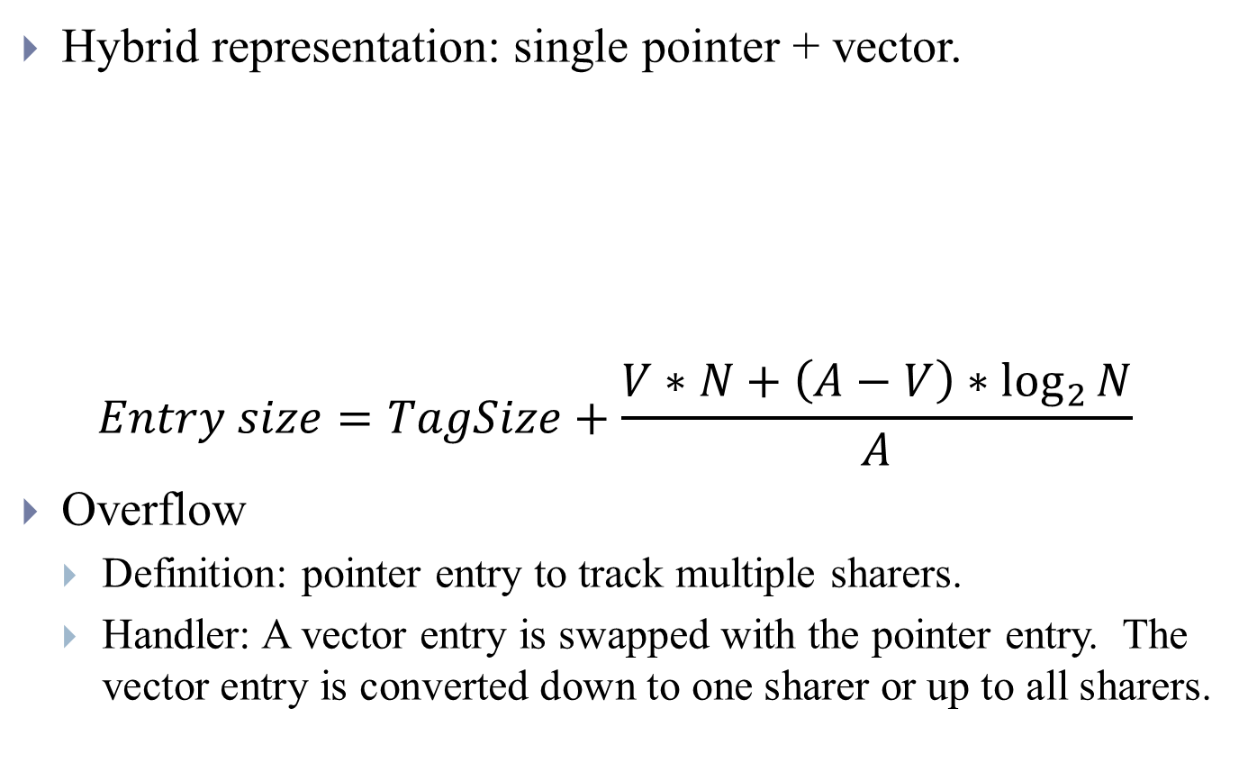
Implementation of hybrid representation
Hybrid representation: single pointer + vector.
$$Entry size=TagSize+\frac{V∗N+\left(A−V\right)∗\log_{2}{N}}{A}$$
Overflow
  Definition: pointer entry to track multiple sharers.
  Handler: A vector entry is swapped with the pointer entry. The vector entry is converted down to one sharer or up to all sharers.

Slide 7
Multi-granular tracking
People have proposed to identify the pattern of region and avoid tracking the private or read only regions.
We exploit the consequence (of private pages etc) that consecutive blocks may have the same access pattern.
We try to use a region entry to track the entire region.

Slide 8
Implementation of multi-granular tracking
Region entry: blocks with similar pattern.
Line entry: exceptional blocks.
Simple implementation
  Start with region entry;
  Use line entry for exceptional blocks.

Slide 9
Hardware support
Grain size bit for distinguish.
Index of line entries align with region entry.
Region entry and line entries for the same region reside in the same set.
When both are found, the line entry takes priority.

Slide 10
Sizing of regions
A larger region size create a more compact tracking when the region is homogeneous.
It can lead to more space waste when the actual size of a region with homogeneous sharing pattern is smaller.

Slide 11
System setup
Simulator based on SimpleScalar with extensive modification.
  Directory protocols models all stable and transient states.
Multi-threaded apps Including SPLASH-2, PARSEC, em3d, jacobi, mp3d, shallow, tsp.
Processor core
Fetch/Decode/Commit ROB Issue Q/Reg. (int, fp) LSQ (LQ, SQ) Branch predictor -Gshare -Bimodal/Meta/BTB Br. mispred. Penalty | 4 / 4 / 4 64 (32, 32) / (64, 64) 32 (16, 16) 2 search ports Bimodal + Gshare 8K entries, 13 bit history 4K / 8K / 4K (4-way) entries At least 7 cycles
Memory hierarchy
L1 D cache (private) L1 I cache (private) L2 cache (shared) | 16KB, 2-way, 64B, 2 cycles, 2ports 32KB, 2-way, 64B, 2 cycles 256KB slice, 8-way, 64B, 15 cycles, 2ports
Directory cache | 128 sets slice, 8-way, 15 cycles, 2ports
Intra-node fabric delay | 3 cycles
Main memory | At least 250 cycles, 8 MEM controllers
Network packets | Flit size: 72-bits Data: 5 flits, meta: 1 flit
NoC interconnect | 4 VCs; 2-cycle router; buffer: 5×12 flits Wire delay: 1 cycle per hop

Slide 12
Experimental result of hybrid representation
The ratio of vector entries: associating 25% of the entries with vector causes an increase of 0.4% in cache miss.
The figure shows the normalized performance with 2 vector in the 8-way set in 16-way CMP. The area reduction is 1.3X. The average degradation is less than 0.5%.
For 64-way CMP, the area reduction becomes 2X with little impact.

Slide 13
Comparison for hybrid representation
Compare HR with other schemes in 64-way CMP.
 | Area reduction | Increment of network packets(%) | Increment of execution time(%)
HR | 2X | 0.4 | 0.6
LP[1] | 1.8X | 8.0 | 8.5
LP+HR | 2.5X | 8.1 | 8.8
CV[2] | 1.8X | 2.7 | 2.4
CV+HR | 2.5X | 2.8 | 2.5
SCD[3] | 2.1X | 9.3 | 10.2
SCD+HR | 2.6X | 9.6 | 10.7
HR outperforms other schemes and causes negligible degradation.
HR is orthogonal to other schemes.
[1] A. Agarwal “An Evaluation of Directory Schemes for Cache Coherence,” ISCA1988
[2] A. Gupta “Reducing Memory and Traffic Requirements for Scalable Directory-Based Cache Coherence Schemes,” ICPP1990
[3] D. Sanchez “SCD: A Scalable Coherence Directory with Flexible Sharer Set Encoding,” HPCA2012

Slide 14
Experimental result of multi-granular
Sizing of region: size of 16 achieves the best performance.
The impact on performance as the size of directory shrinks.
1.6%
2.4%
5.9%

Slide 15
Comparison for multi-granular
Page-bypassing
  Identify the pages with the aid of TLB and OS;
  Avoid tracking private or read only pages.
Impact of page-bypassing/MG/page-bypassing + MG
Notes:
Previous work proposed to identify the region on the page level with the aid of TLB and OS. Then they avoid tracking the private and read only pages and the number of directory entries can be reduced. We call it page-bypassing scheme. Here I am going to show the comparison of our MG scheme with page-bypassing scheme.
In this plot, on the X axis, I am showing the number of directory cache sets. The associativity is fixed to be 8. On the Y axis, I am showing the performance normalized to full blown directory cache. The trend line on the bottom is for page-bypassing. The one in the middle is for MG. And the top one is for combination of page-bypassing and MG. As you can see, we achieve comparable or less performance impact with far less architecture support. We have only simple modification in the indexing and tag matching logic of the directory without any system level support such as TLB or OS. You can actually combine the 2 techniques to reach even better result as the figure shows.

Slide 16
Combination of HR and MG
Since the two techniques work on different dimensions, they can be combined in a rather straightforward manner.
In a directory cache with multi-granular tracking, the sharer list can be implemented in either pointer or vector format as in hybrid representation.
We implement the combination of HR and MG in a 16-way CMP. The area reduction is 10X and the performance impact is about 1.2%.

Slide 17
Conclusion
We have proposed an expressive, area-efficient directory.
Two techniques:
  HR: reduce the size of directory entry
  MG: reduce the number of directory entries.
Simple hardware support without any OS or software support.
When combine the 2 techniques together, the storage of directory can be reduced by more than an order of magnitude with almost negligible performance impact.

Slide 18
Building Expressive, Area-Efficient
Coherence Directories
Lei Fang, Peng Liu, and Qi Hu
Zhejiang University
Michael C. Huang
University of Rochester
Guofan Jiang
IBM

